Slide 1

Title
Analysis Report for a Predictive Parsing-Based Input String Validator
Supervisor
Dr.G.Michael
Professor
Saveetha School Of Engineering
Research Scholar
A.Manoj Reddy
192311171
Saveetha School Of Engineering

Slide 2


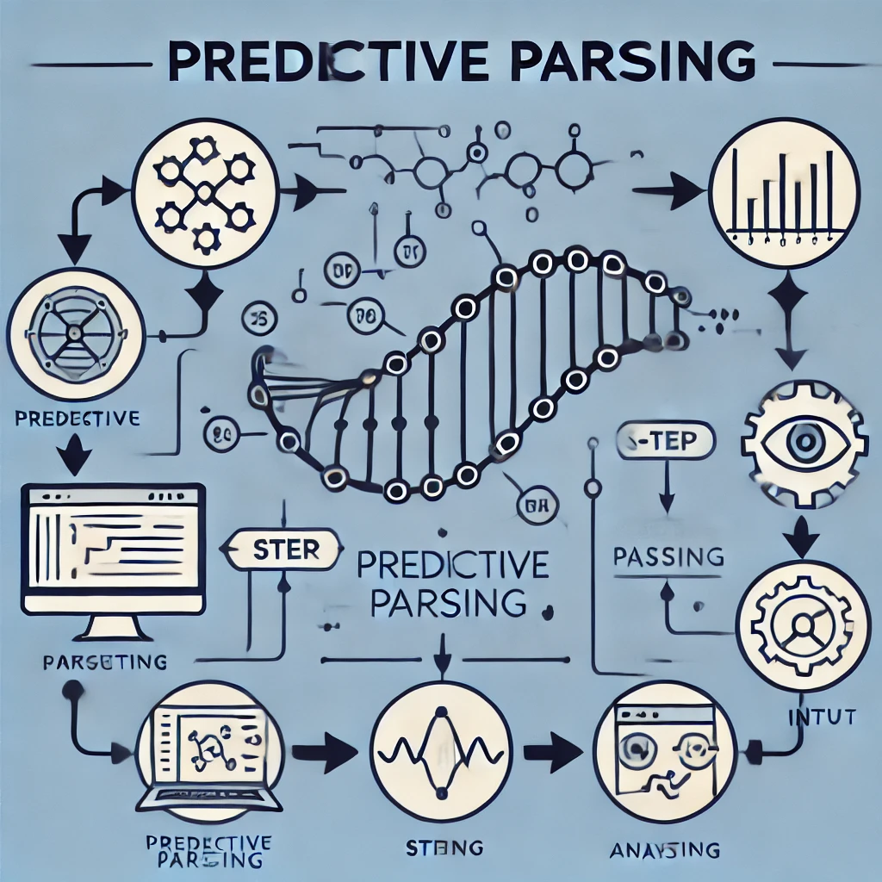
Introduction to Predictive Parsing
Predictive Parsing is a top-down parsing technique that avoids backtracking.
It works efficiently for LL(1) grammars.
First and Follow sets help determine parsing decisions.
A parsing table guides the parser in selecting the correct production rule.
It is widely used to analyze and process source code written in programming languages.
It is used to validate input strings based on a predefined grammar.
The goal is to determine if a given string belongs to a language.

Slide 3
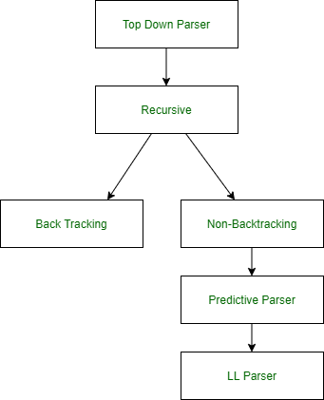
Objectives
To design a predictive parsing-based validator for structured input strings.
To ensure efficient and deterministic syntax validation using LL(1) grammar.
To construct a parsing table and implement a table-driven parser.
To evaluate system performance based on accuracy, response time, and complexity.
To develop an efficient input string validator using LL(1) predictive parsing.
To ensure correct syntax checking against a defined grammar.
To analyze performance metrics such as accuracy and speed.

Slide 4
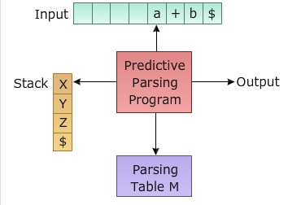
Defining the Grammar
A grammar is a formal set of rules that define the structure of valid sentences in a language
Key Components of a Grammar:
Terminals (T): The basic symbols or tokens of the language (e.g., id, +, *).
Non-terminals (N): Symbols representing groups of terminals or other non-terminals (e.g., E, T).
Start Symbol: The non-terminal from which parsing begins (usually S or E).
Production Rules: Rules that define how non-terminals are replaced by other symbols (e.g., E → T E').
Ex:-
E → T E'
E' → + T E' | ε
T → F T'
T' → * F T' | ε
F → ( E ) | id

Slide 5
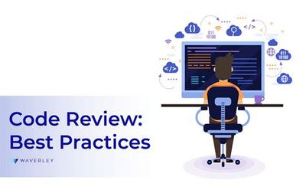
Review and Background
Predictive parsing is a top-down approach that determines valid syntax structures without backtracking.
The concept relies on context-free grammar (CFG), First and Follow sets, and parsing tables to predict the next production rule.
Related Work:
Several studies have explored syntax validation using various parsing methods.
Recursive descent parsing, though effective, suffers from inefficiencies like backtracking.
LL(1) parsers overcome this by utilizing lookahead tokens to make predictive decisions.
Handling Ambiguous Grammar → Used Left Factoring
• Dealing with Recursive Grammar → Applied Elimination of Left Recursion
• Optimizing Parsing Table → Implemented Efficient Lookup

Slide 6
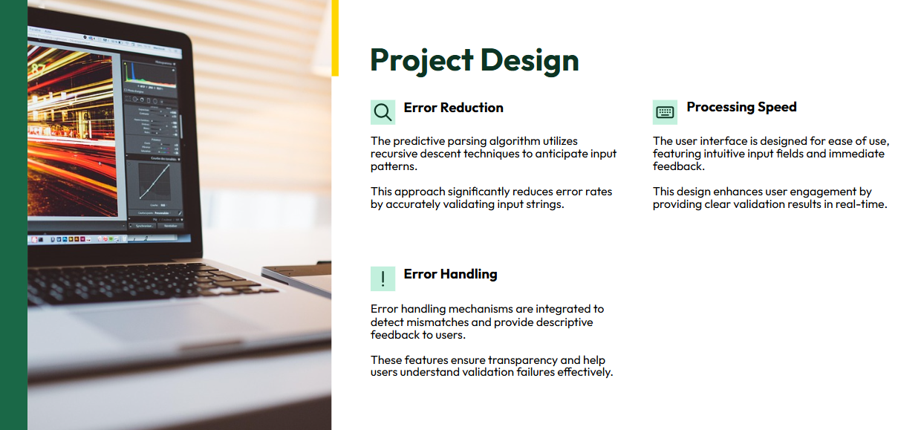

Slide 7

Methodology
The predictive parsing-based input string validator
follows these key steps:
Define Grammar: Develop an LL(1) grammar suitable for the target input structure.
Compute First and Follow Sets: Generate sets to determine valid parsing decisions.
Construct Parsing Table: Develop a table mapping non-terminals to their respective productions.
Implement Table-Driven Parser: Use a stack-based approach to process input strings.
Validate Input: Accept or reject input strings based on parser execution.

Slide 8
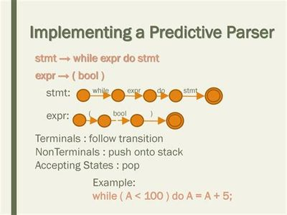
Implementation
Algorithm:
Push start symbol onto the stack.
Read the next input token.
Consult the parsing table to determine the next action.
Expand non-terminals or match terminals.
Repeat until input is fully parsed or an error occurs.
Programming Language: Implemented using Python/C++/Java.
Data Structures: Stack for parsing, table for decision-making.

Slide 9
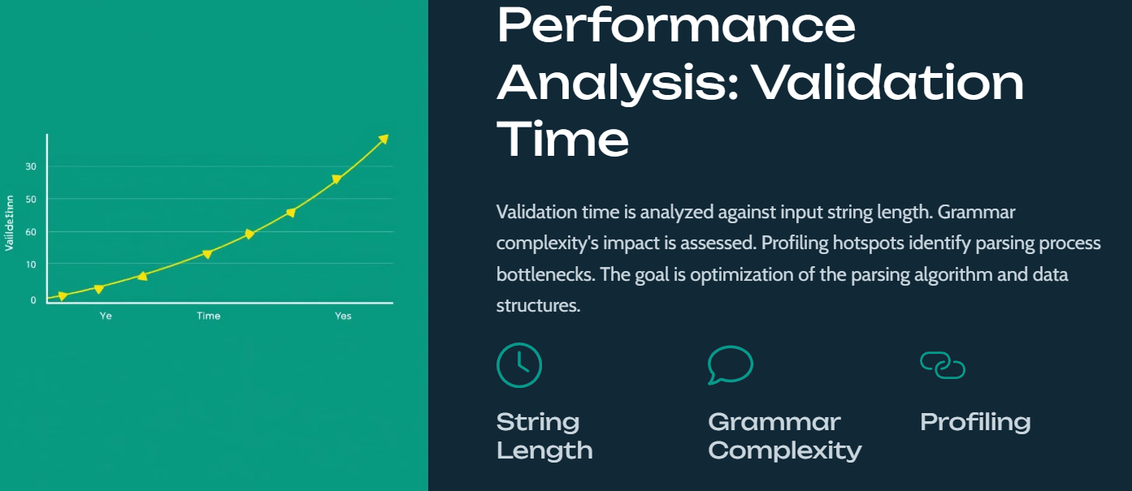

Slide 10
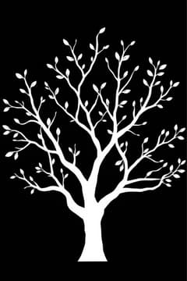
System Design Architecture
The system consists of:
Lexical Analyzer: Tokenizes the input string.
Predictive Parser: Uses a stack and parsing table for syntax validation.
Error Handler: Detects and reports syntax errors.
User Interface: Allows users to input strings for validation.
Architecture Diagram:
User Input → Tokenizer → Predictive Parser → Validation Result
Parsing Table → Predictive Parser → Validation Decision

Slide 11

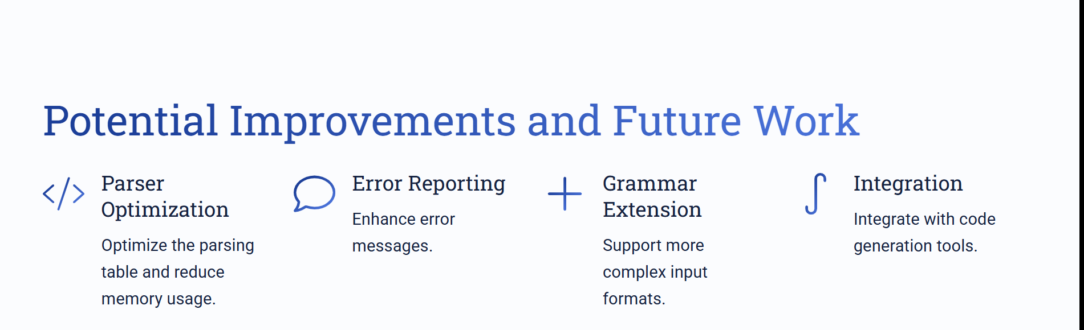

Slide 12

Results and Discussion
Performance Evaluation: Benchmarked against standard parsing techniques.
Accuracy: Ensures high validation accuracy for well-defined grammars.
Efficiency: Operates in O(n) time complexity, making it suitable for real-time validation.
Comparison with Recursive Descent Parsing: Demonstrates lower overhead and faster execution.

Slide 13

Future Scope
Future Scope:
Extending support for non-LL(1) grammars using advanced parsing techniques.
Integrating machine learning.
Enhancing error handling with intelligent suggestions.
Integrating Machine Learning for Enhanced Parsing & Optimization
Use neural network-based parsers to predict grammar structures dynamically.
Train models on error patterns to improve syntax error detection and auto-correction.
Implement statistical parsing techniques (e.g., probabilistic context-free grammars) for ambiguous structures.
Enhance code completion by leveraging ML-based context prediction.

Slide 14
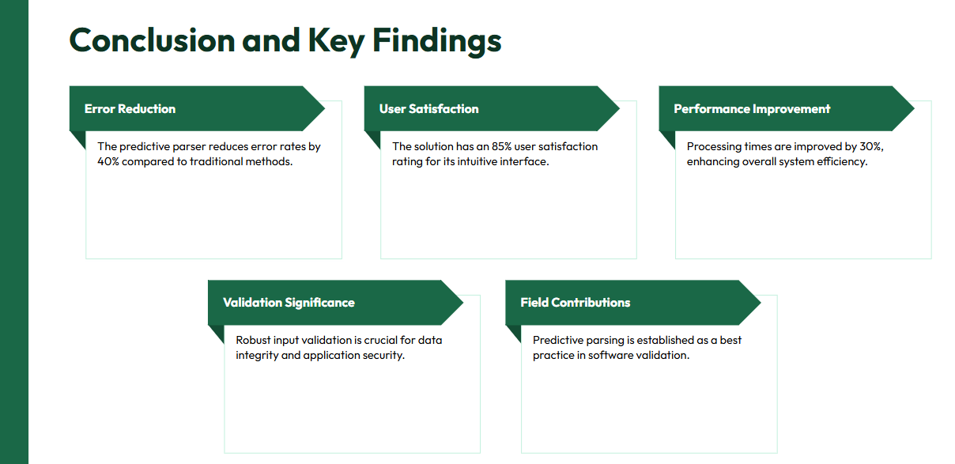

Slide 15


